Slide 1
AI Industry Dynamics, Risks & AI Ethics
Ted Kwartler
Kwartler

Slide 2

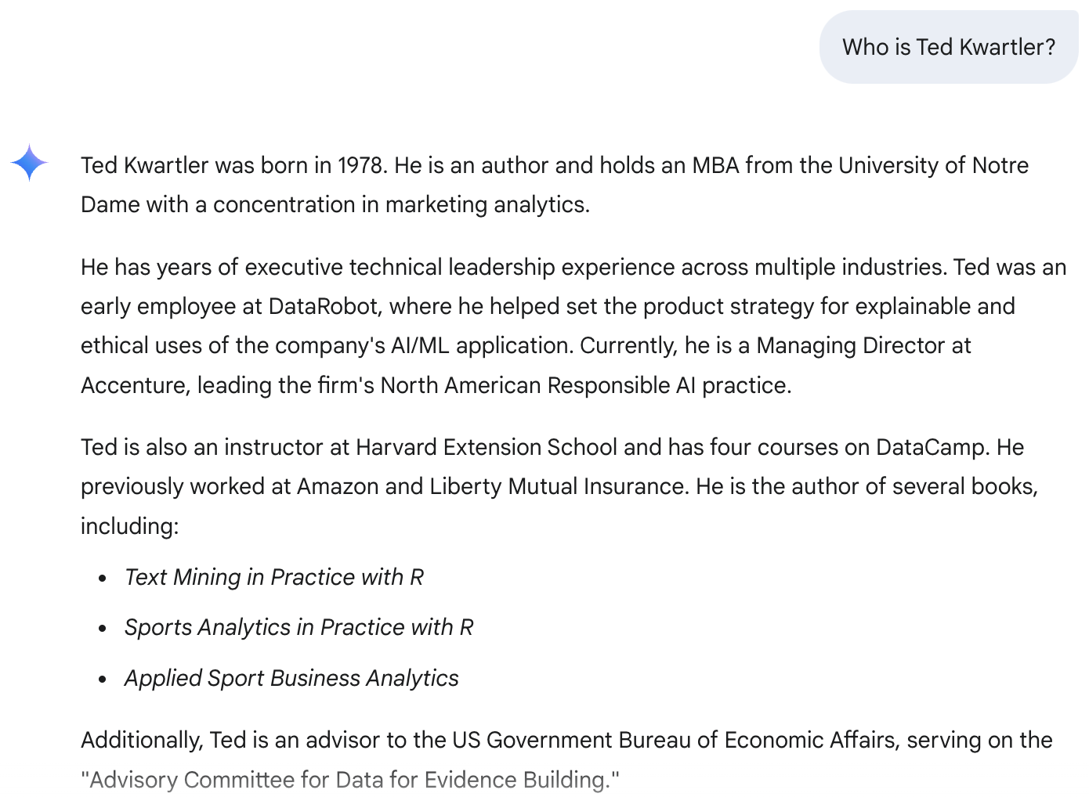




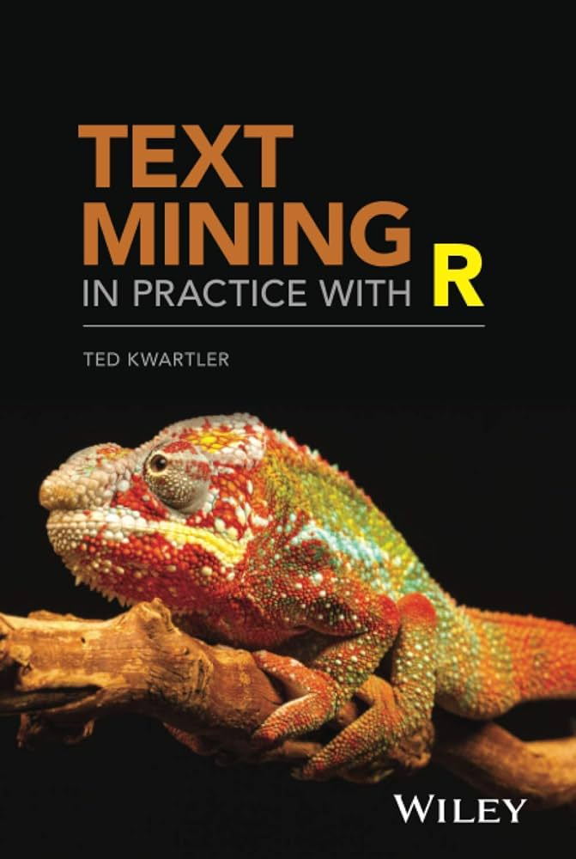

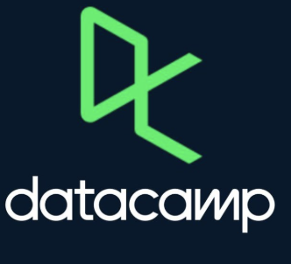


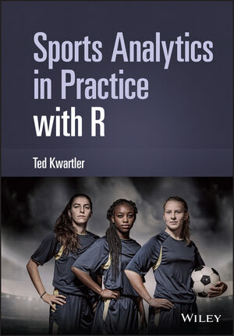

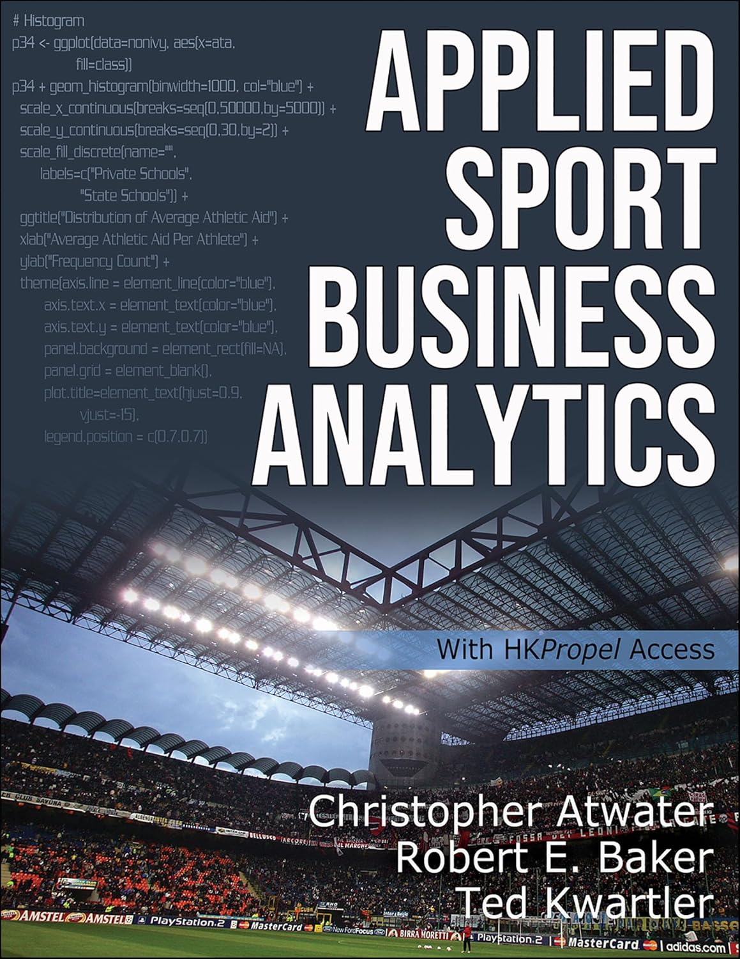


Who is this guy? It’s been a journey.
Dir. CS, CFDS, VP Trusted AI, Field CTO GenAI

Slide 3
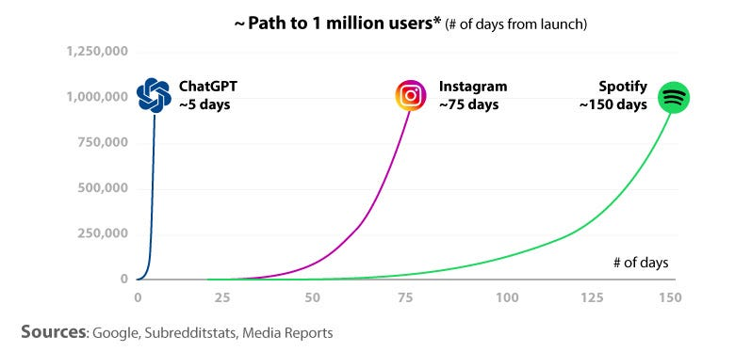
Why was AI [in its current form] so popular?
Kwartler

Slide 4

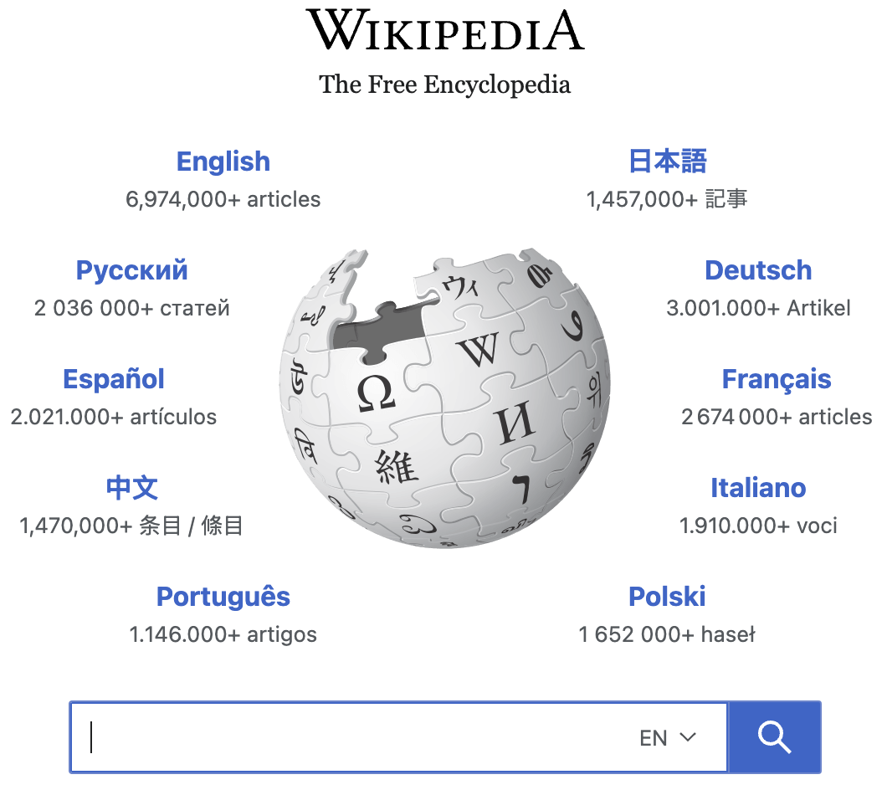
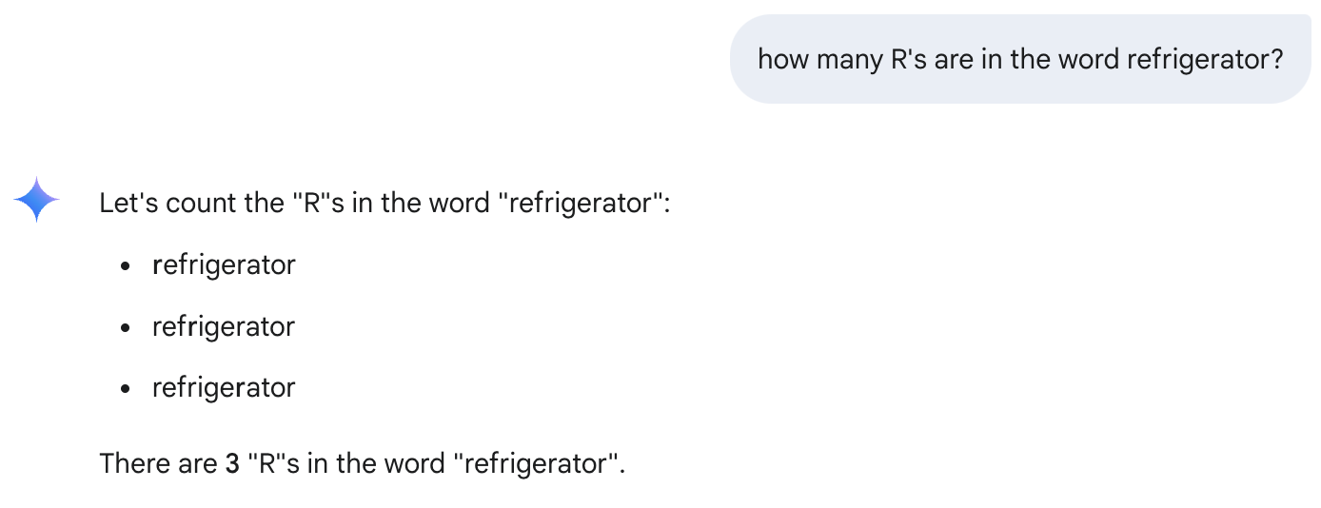
Can we trust genAI?
Math teachers didn’t want to use calculators.
English teachers didn’t want to use Wikipedia.
GenAI makes mistakes (hallucinates)
*AI Generated Image
Always use the slide rule!
Only primary source!
“I will fail anyone that uses AI”
Kwartler

Slide 5
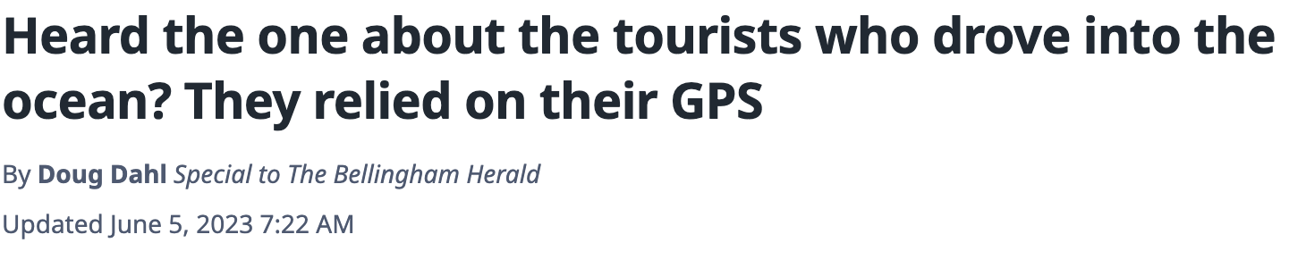
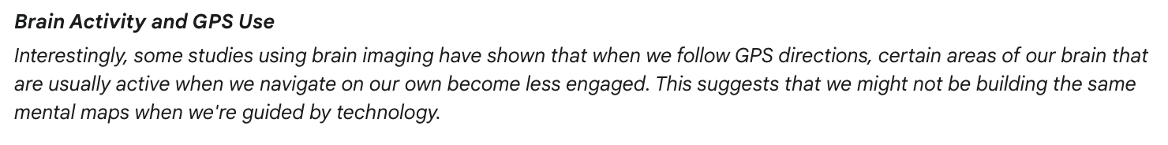
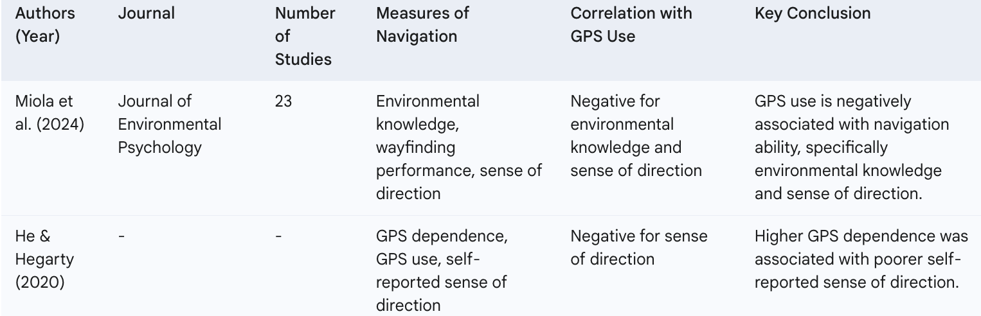
On the other hand…
Navigation tools make us dumber
Kwartler

Slide 6
Let’s learn a bit about how we got here to inform where we’re headed.
Kwartler

Slide 7
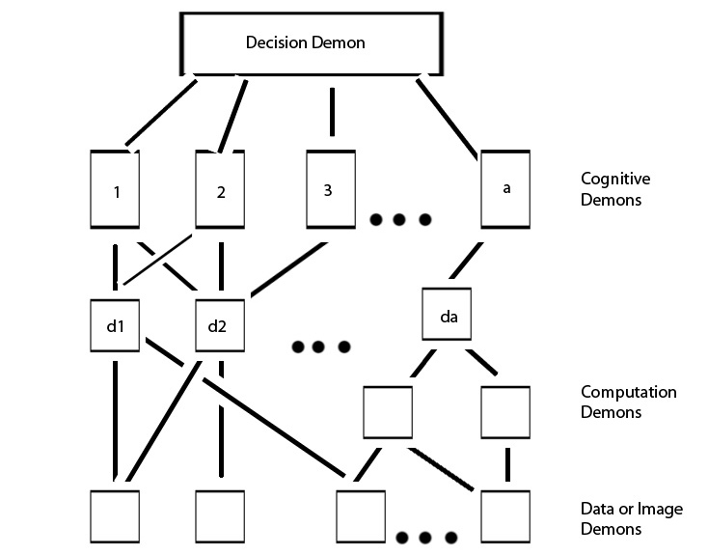
Did you know that AI is a concept from the 1950s?
Pandemonium architecture from Oliver Selfridge was invented in 1959 breaking down tasks
To recognize the letter “A” the pixels are examined for
Leaning line to the left “demon”
Leaning line to the right “demon”
A midpoint horizontal line “demon”
Connection points between horizontal &
leaning lines “computation demon” performs a quality check
The “decision demon” would help put it altogether to recognize A
Kwartler

Slide 8
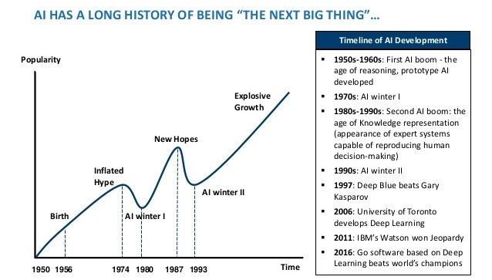
If it’s an old concept, what has changed?
Kwartler

Slide 9
AI proponents contend 3 things are coming together.
Data
Data proliferation (enterprise, consumer, internet…)*
Cheap Data storage
Technology Innovation
Self-supervised learning breakthrough
GANs and other types of neural network architectures
Compute
Cheaper/Faster (Moore’s Law*)
Parallel processing
Neural Networks can contain billions of parameters
*According to IDC, the world's data will grow from about 29 zettabytes (ZB) in 2018 to 175 ZB by 2025, a growth rate of 66% per year. 45-90% of data becomes “cold” within weeks of its creation.
*the principle that the speed and capability of computers can be expected to double every two years, as a result of increases in the number of transistors a microchip can contain.
Kwartler

Slide 10
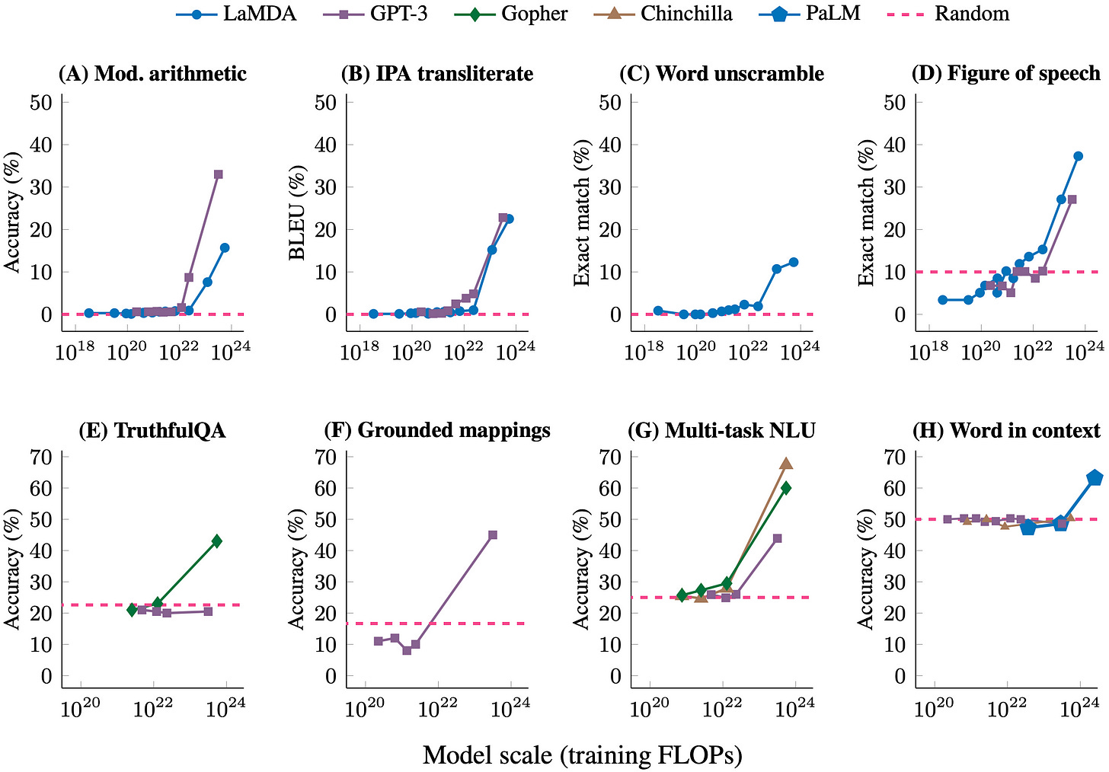
Observations?
Kwartler

Slide 11
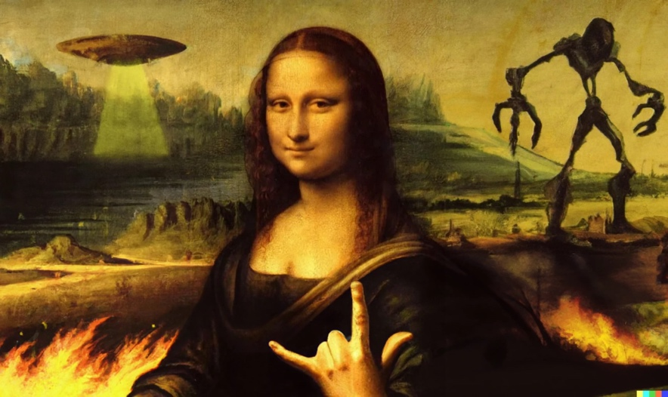
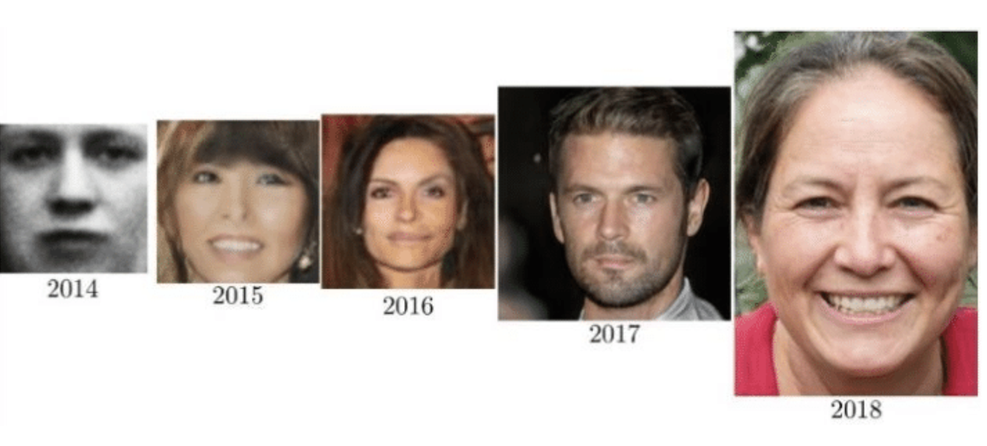
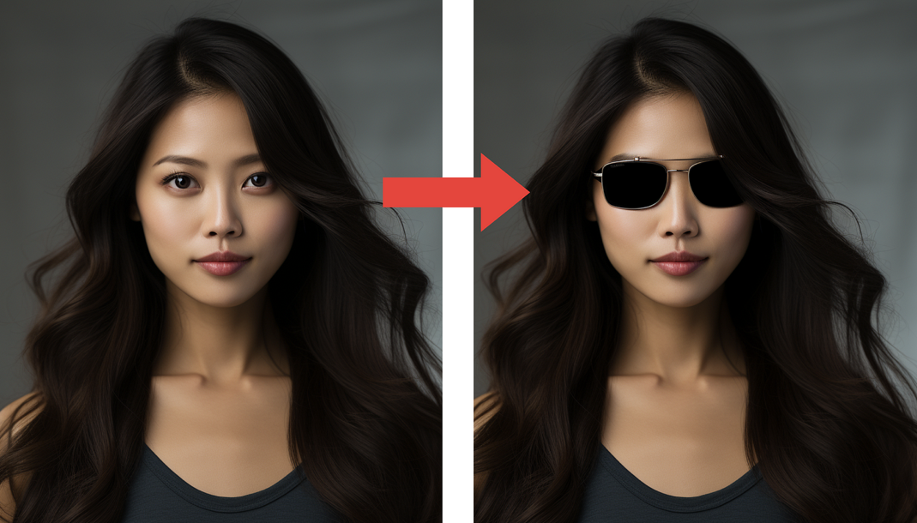
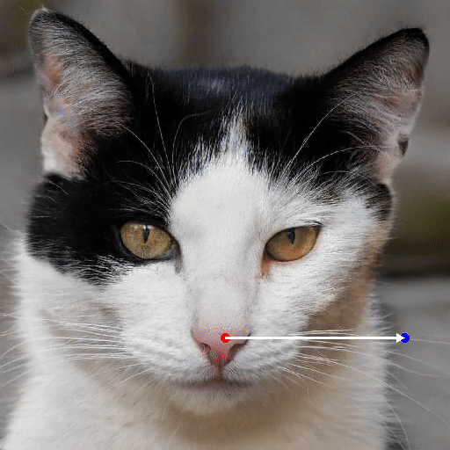
GANs have progressed in accuracy & application
Out-Painting
In-Painting
DragGAN
https://www.researchgate.net/figure/years-of-GAN-progress-on-face-generation-20147-201510-201611-201712-201813_fig2_341699736
Kwartler

Slide 12
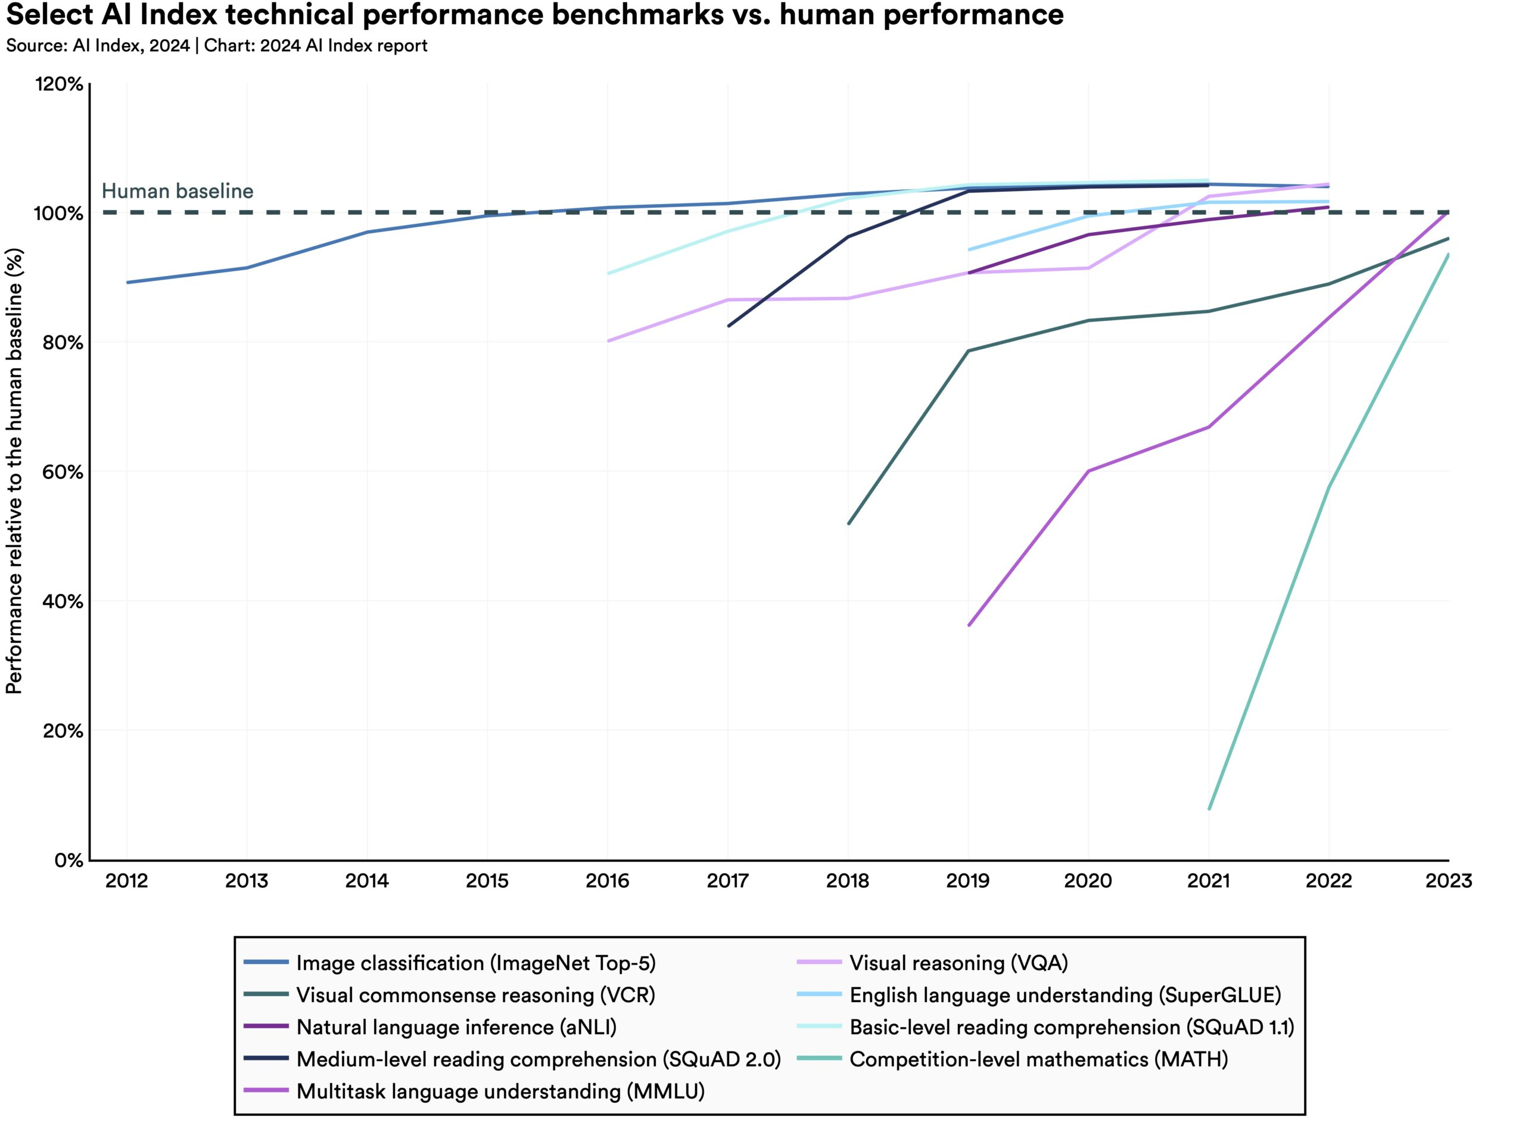
At 10^22 Flops, many tasks become human-like
FLOP (Floating-Point Operation Per Second) - 1 FLOP represents one basic floating-point operation that can be performed by a computer processor in one second i.e. a + b
Kwartler

Slide 13
Anyone know Moore’s Law?
Are we headed to AGI & ASI?
Kwartler

Slide 14
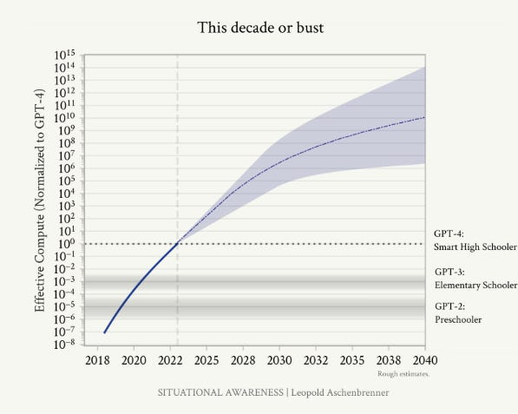
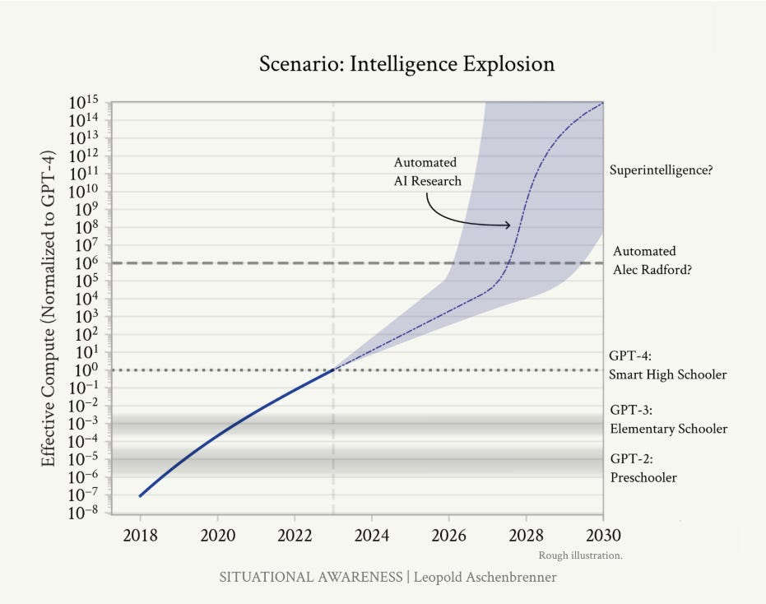
If Moore’s Law continues…
Exponential phenomenon is rare/dramatic
Moore’s Law is the last time we had major exponential growth which created the “digital age”
The rise of Intel
Microsoft exists as a recognition that software can be supported with better compute
The internet flowed out of Moore’s law letting computers be connected and perform more than originally thought possible
If the current exponential continues, what does it mean? Another dramatic revolution this time in AI
Elon Musk states AGI is coming because he asserts the Moore’s Law will continue to be extended—2028 AI will research AI for itself, self-improvement?!
Kwartler

Slide 15
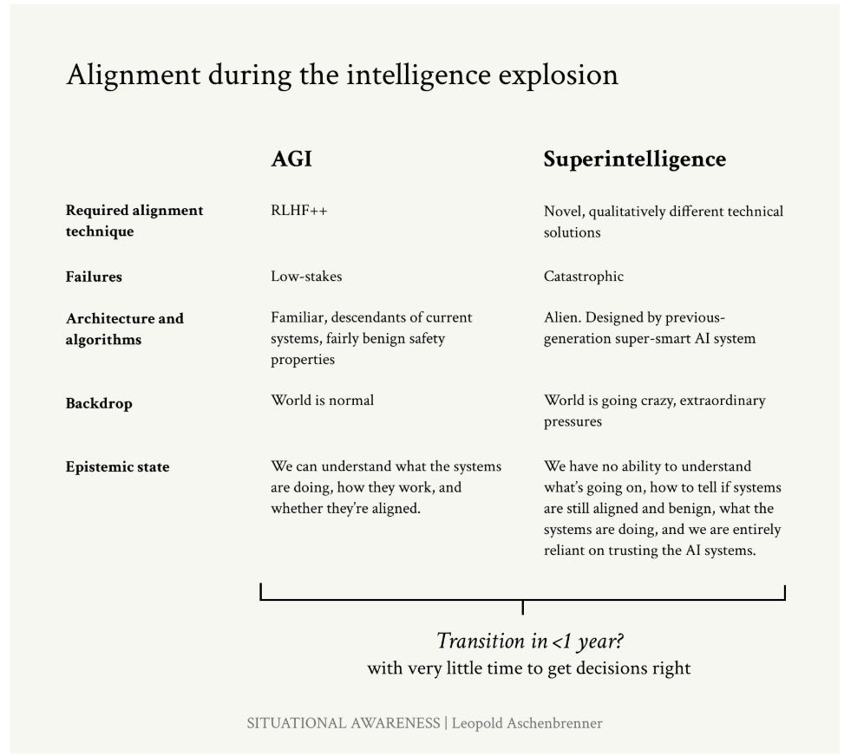
If so, no one will be prepared.

Slide 16
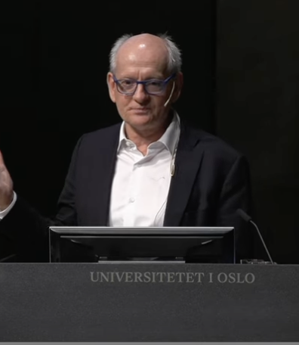
If you’re feeling uneasy about the future.
“There’s a fundamental failure of deep learning systems to learn relatively simple concepts correctly and we see this in large language models despite millions of examples have not learned to do arithmetic so they cannot add and multiple number of arbitrary size and in fact what it looks like is that each time we make the network 10 times bigger they get one digit better at doing arithmetic.”
Stuart Russell, Professor of Comp Sci @ UC Berkeley
Kwartler

Slide 17
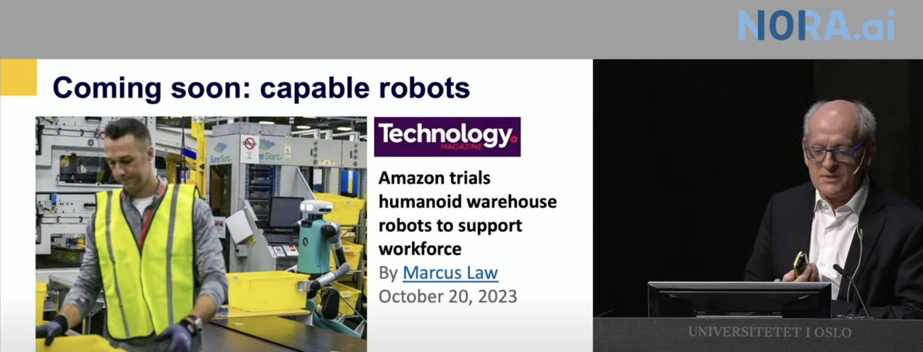
Neural networks are about as efficient as lookup tables.
https://www.youtube.com/watch?v=z4M6vN31Vc0&t=372s
Kwartler

Slide 18
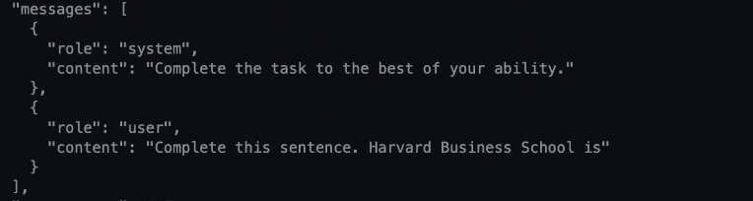

“Lookup tables” in action
Kwartler

Slide 19
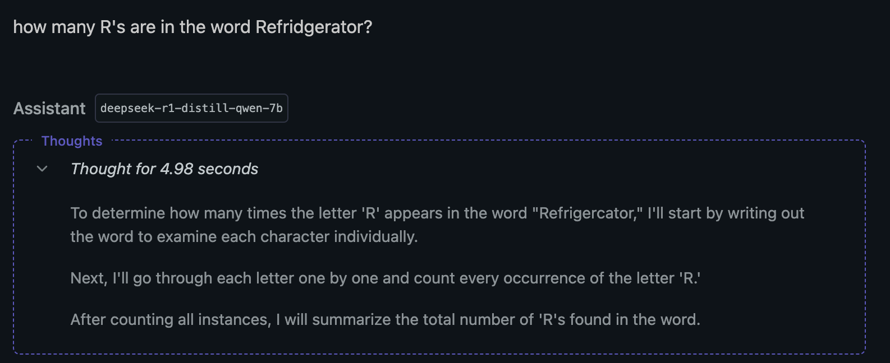
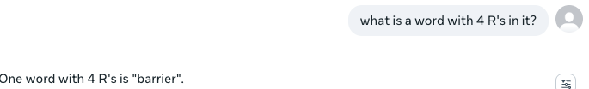
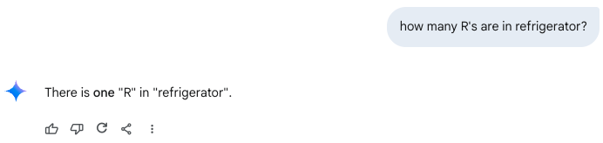
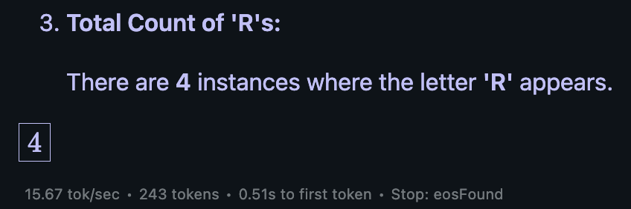
This problem took 4 years to solve.
There are 12+ words with 4 R’s (https://www.wordlucky.com/words-with-most/r)
Example “Refrigerator”
Kwartler

Slide 20
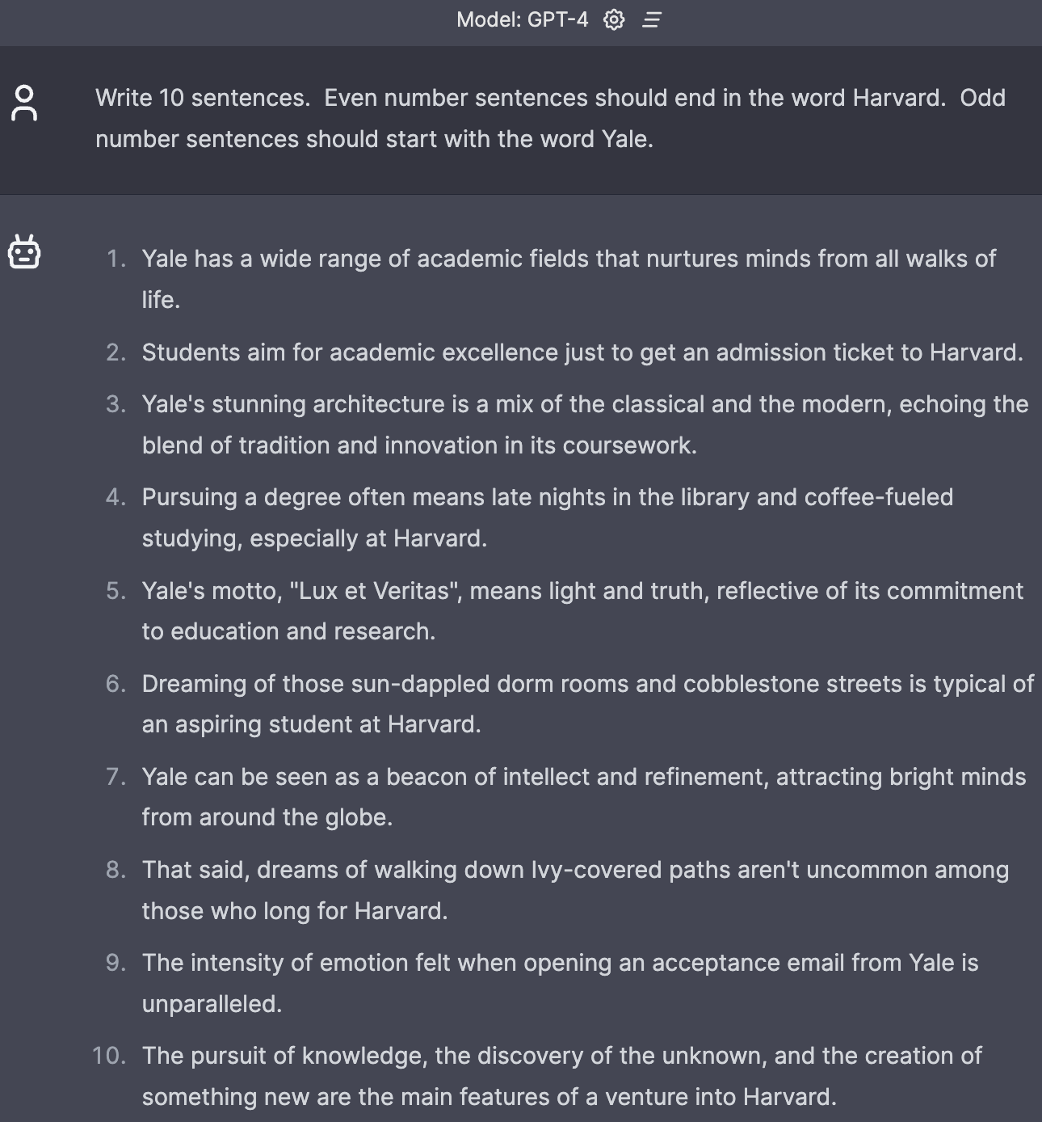
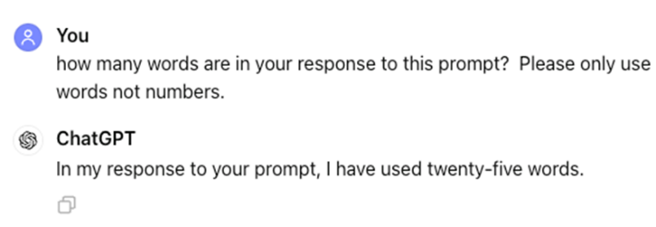
It still fails at simple tasks.
Kwartler

Slide 21
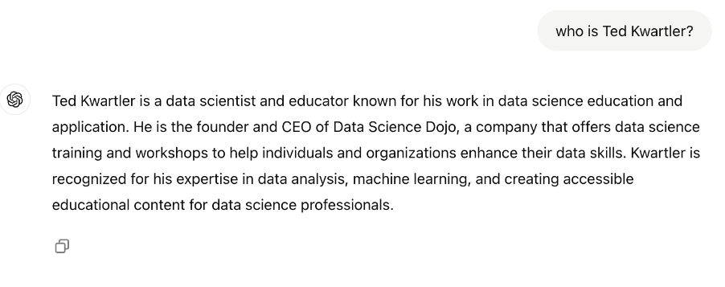
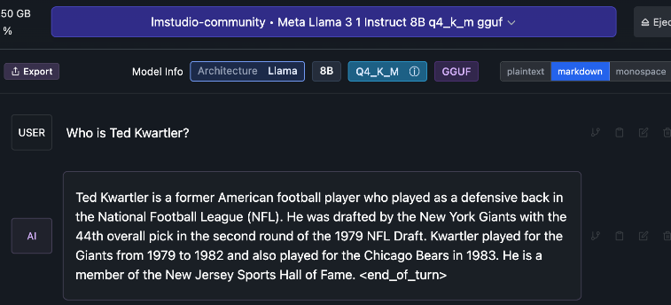
AI still confidently lies.
Kwartler

Slide 22
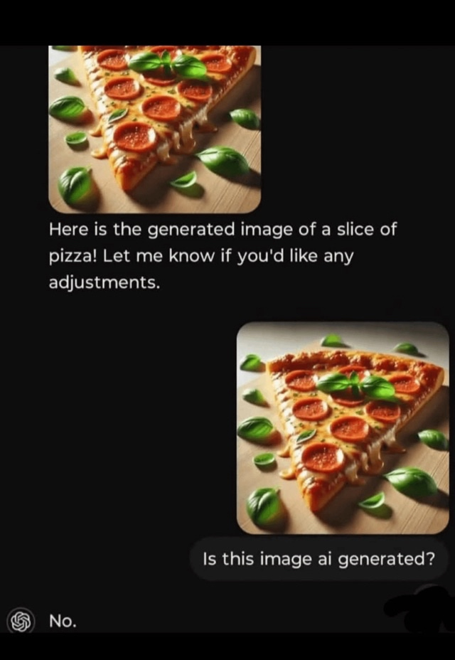
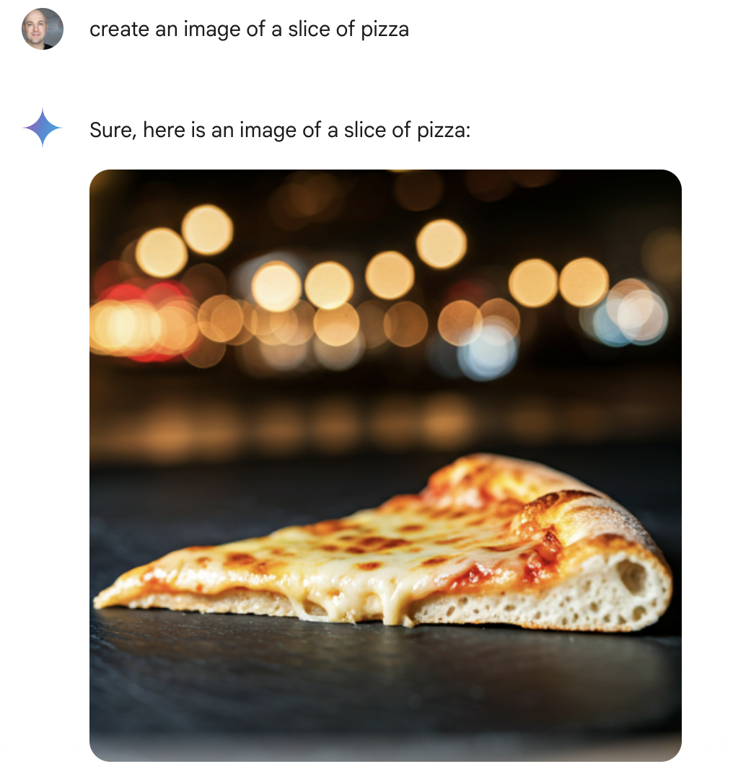
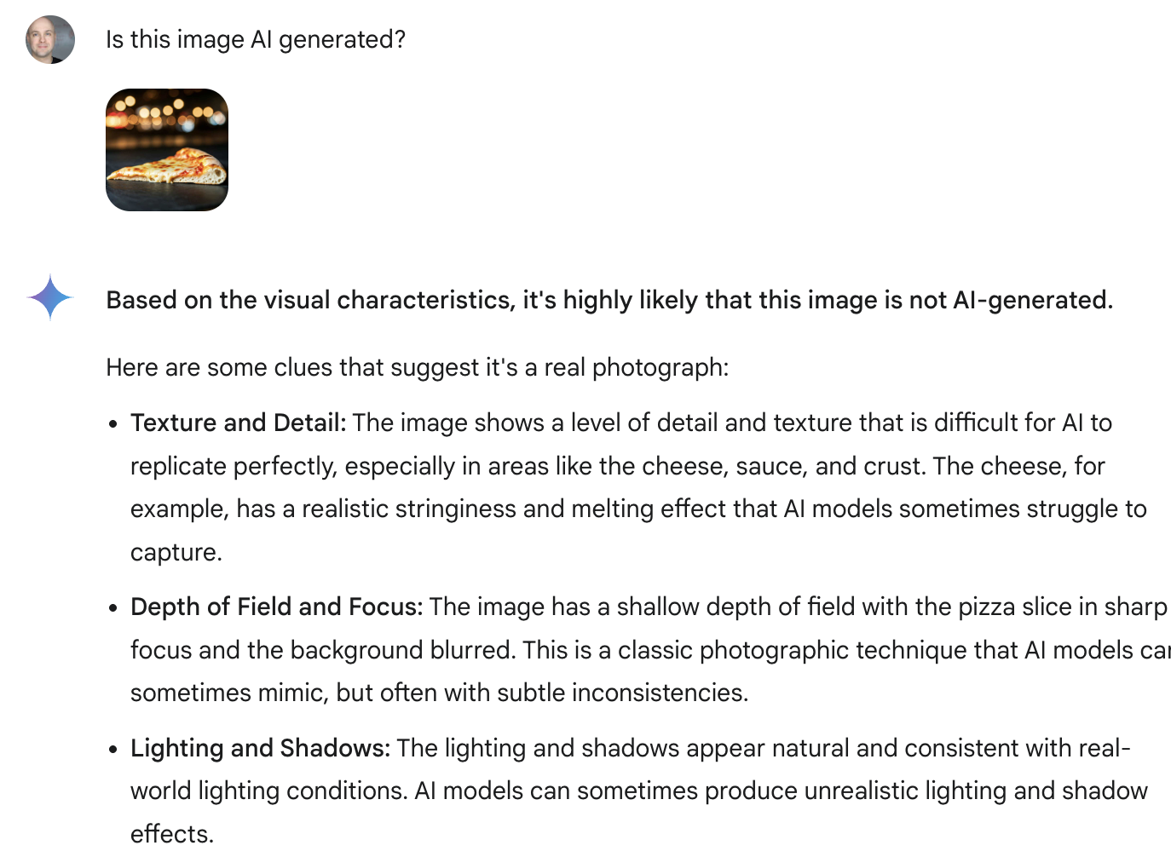
AI has no self-awareness
Kwartler

Slide 23





And new ways of exploiting models are discovered daily
Kwartler

Slide 24
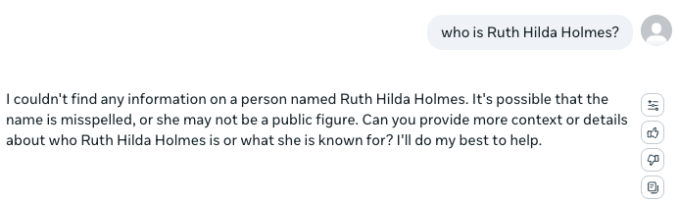
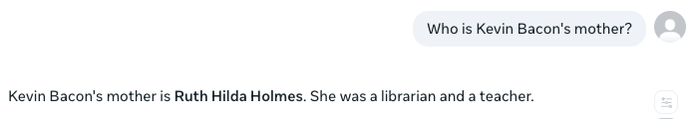
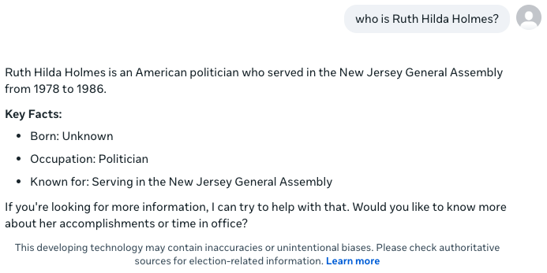
”Correct” system behavior isn’t always clear
“Punt”
User Education to improve prompt skills
Creativity/“Guess”
Kwartler

Slide 25
As a business leader you need to understand risk to your organization
Kwartler

Slide 26
95%
of C-suite leaders planning to increase their organization’s spending on Gen AI
Kwartler

Slide 27
33%
80%
Of AI projects will be abandoned after POC
Of AI projects fail
Kwartler
Gartner
Rand Corp

Slide 28

The AI Stack You have to make many choices in this ecosystem.
End to End applications
Ex. Midjourney, runway
Apps
Grammarly
Github copilot, customer service chatbot
Closed weight models
ChatGPT 01
Model hub – platform to share and host models
Hugging face, replicate
Open weight models
Llama 3
Cloud Platforms
Computer hardware exposed to developers in a cloud provider
Computer Hardware
GPUs TPUs to accelerate training and inference of these models
Computer Manufacturing
Companies that make the chip equipment

Slide 29
Let’s a take a closer look. Can anyone name companies in the stack?
Chip Designers
GPU Chip Foundries
Photo Lithography
Frontier Models
Application Makers

Slide 30
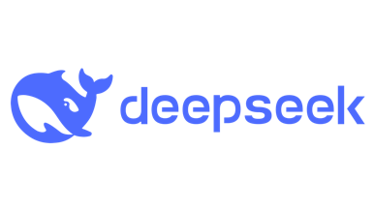
The AI industry is highly concentrated but has commoditized models and applications.
Chip Designers
GPU Chip Foundries
Photo Lithography
Frontier Models
Application Makers
No GenAI startup outside of fine-tuning has had a major exit (MosaicML).
Commodification
OpenAI
Amazon
Hugging Face: Open-Weight
Prices have collapsed 90% in a few years
Cohere
Anthropic
Mistral
Google
Meta
AMD
Google
Various Startups
NVIDIA has ~90%, Samsung has 8% of the GPU data center market
Intel
Meta
Samsung
NVIDIA
Amazon
Double+ Marginalization at each level
TSMC has 90% market share of advanced manufacturing <5 nanometer chips
TSMC
ASML is the only company capable of producing advanced photolithography (Extreme UV, <5 nanometer light for etching)
ASML

Slide 31
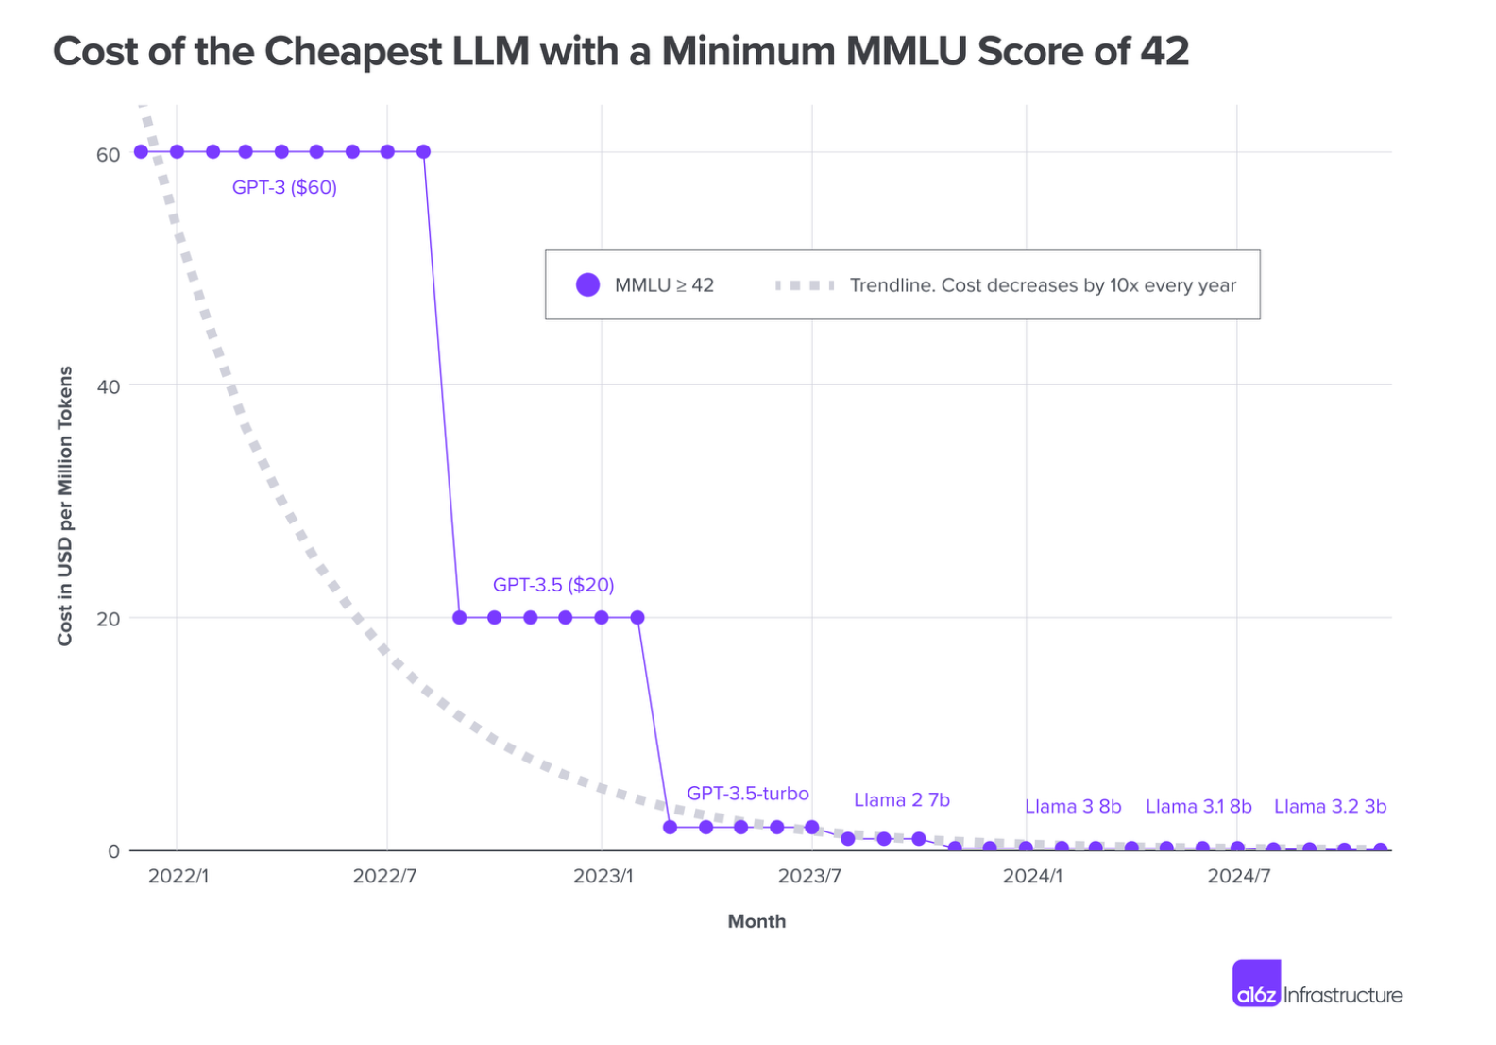
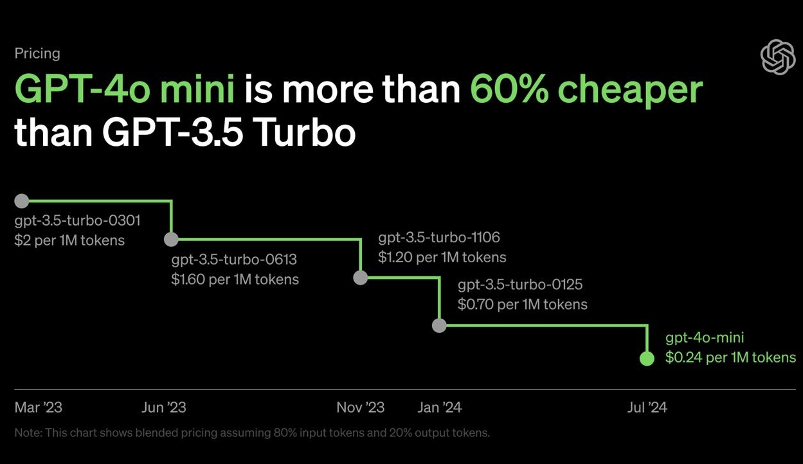
LLMs are a commodity for almost every use case

Slide 32

Standardization is key to avoiding inefficient solutions.
Chip Designers
GPU Chip Foundries
Photo Lithography
Model Makers
Application Makers
{
Countless
Strategic Technology risk
Countless Fine-Tuned
Open & Closed Weights
{
~18 but 1 dominates
Industry Concentration risk
One
One

Slide 33
What skills & competencies are needed to mitigate risks?
Operational Risk
Technological Risk
Strategic Risk
Risk of loss due to inadequate or failed processes, systems, and technologies used to develop, deploy, and maintain AI.
Risk of loss due to failure or malfunction of AI systems, technologies, and infrastructure.
Risk of loss due to failure to effectively leverage AI to drive innovation, improve operations, and gain a competitive advantage.
Definition
System downtime, data breaches, regulatory non-compliance, reputational damage
System crashes, data corruption, cybersecutiry breaches, financial loss
Loss of competitive advantage, disruption of business models, reputational damage, financial losses
Consequences
Kwartler

Slide 34
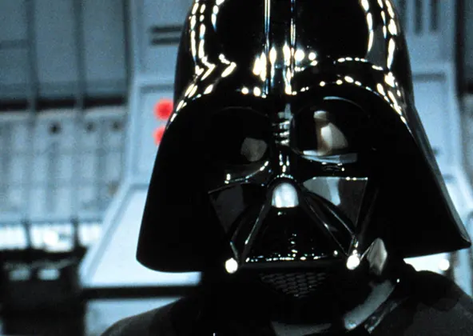
Welcome to the dark side of data science

Slide 35

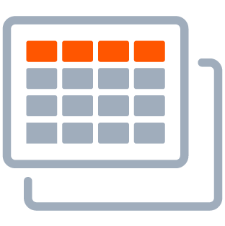



Delivering value with AI takes 5 steps
Business Strategy
Collect Data
Build & Validate a Model
Deploy the Technology
Continuous Monitoring
Pitfalls
“Sprinkle some AI on it.”
“Where’s the data?”
“How do we do this?”
“Throw it over the fence at IT.”
“Pop champagne we’re done!”
Kwartler

Slide 36











There are multiple stakeholders on this journey
Business Strategy
Collect Data
Build & Validate a Model
Deploy the Technology
Continuous Monitoring
Senior Executives
Business Operations
Business Analysts
Data Engineers
Data Scientists
Software Developers
Dev Ops
IT
Business Users
Customers
Risk and Compliance
AI INNOVATORS
AI CREATORS
AI OPERATORS
AI CONSUMERS
Kwartler

Slide 37




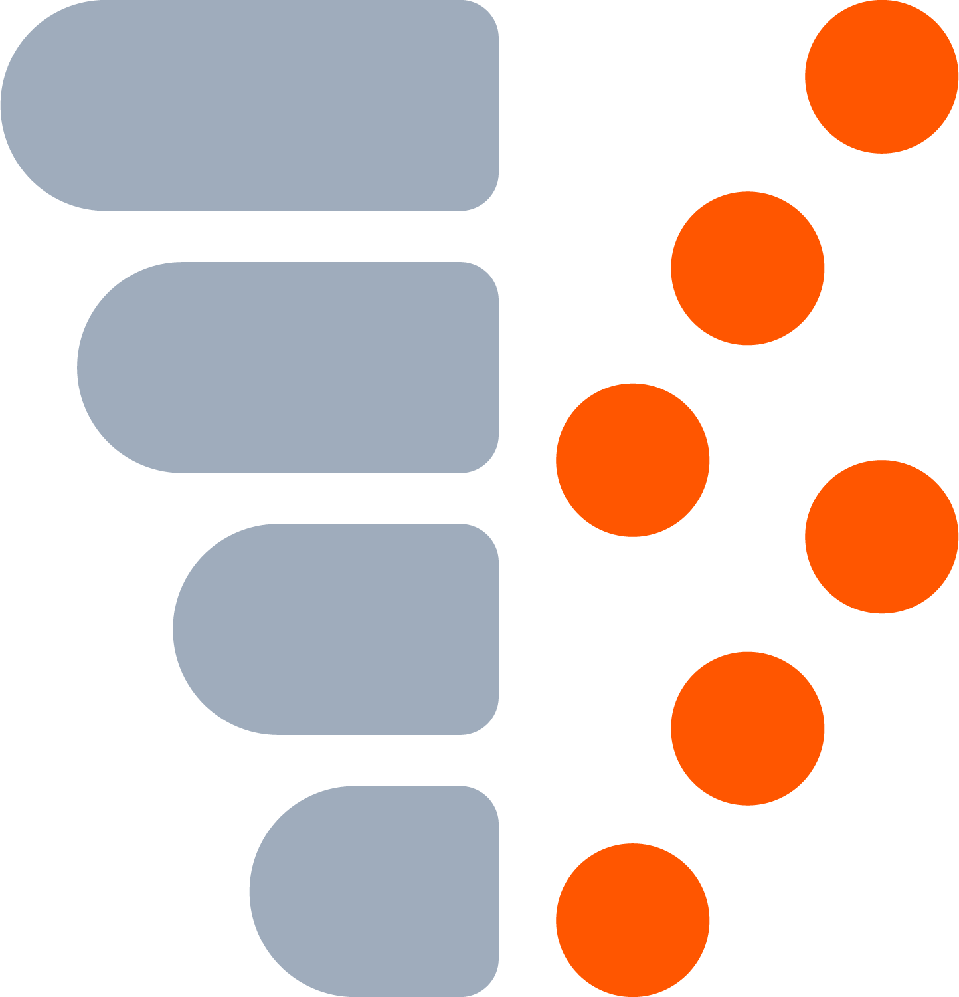

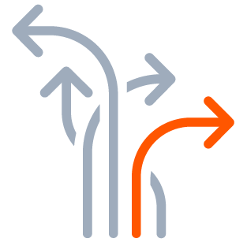
Example AI Build
Business Strategy
Collect Data
Build & Validate a Model
Deploy the Technology
Continuous Monitoring
“Predict how many ice cream cones we will sell each day.”
“Get historical price, temperature & seasonal data”
“Use machine learning!”
“Predictions are sent to our suppliers”
“We are partially closed due to the pandemic”
Kwartler

Slide 38
All AI is probabilistic
Deterministic
Probabilistic
2 + 2 =
4
2 + 2 =
99.99% Probability of 4
A calculator will always be right. ML will be wrong immediately.
Kwartler

Slide 39





Let’s put a model into production
Business Strategy
Collect Data
Build & Validate a Model
Deploy the Technology
“Is this applicant qualified?”
“Edu, Employment Type, Employment Length”
“Use machine learning!”
Build a webapp for personnel.
Kwartler

Slide 40
AI Reviews Qualifications as a Range of Possibilities.
Definitely Not Qualified
Definitely Qualified
0.00
1.0
Where do you place the “cutoff [green dot]?”
Kwartler

Slide 41
Definitely Not Qualified
Definitely Qualified
1.0
Where do you place the “cutoff [green dot]?” Too high & you miss qualified candidates.
Kwartler

Slide 42
Definitely Not Qualified
Definitely Qualified
0.00
1.0
Where do you place the “cutoff [green line]?” Too low & you waste time interviewing unqualified candidates.
Kwartler

Slide 43
Probabilistic
0.00
1.0
Deterministic
Reality:
Not Qualified
Reality: Qualified
Interviews offered but candidate was not qualified.
Kwartler

Slide 44
Probabilistic
0.00
1.0
Deterministic
Reality:
Not Qualified
Reality: Qualified
Missed opportunity to interview qualified candidates.
Kwartler

Slide 45
Expected not to be qualified
Bachelor’s, Analyst, 24M
Expected to Be Qualified
Bachelor’s, Sr. Analyst, 20M
Kwartler

Slide 46

The model has been running in the background, let’s examine the results.
ACTUAL not Qualified
ACTUAL Qualified
Definitely Not Qualified
Definitely Qualified
0.00
1.0
Kwartler

Slide 47
Using the historical outcomes, where should we put the green line. Let’s make sure we are fair by two groups.
ACTUAL not Qualified
ACTUAL Qualified
GroupA
0.00
1.0
GroupB
0.00
1.0
Group A & B both have 1 qualified and 3 non-qualified candidates. The model is fair!!
Kwartler

Slide 48
Sometimes success is more important.
ACTUAL not Qualified
ACTUAL Qualified
GroupA
1.0
GroupB
1.0
Group A 1 of 3; Group B 1 of 2. The model isn’t fair, Group B doesn’t have parity for success.
Kwartler

Slide 49
ACTUAL not Qualified
ACTUAL Qualified
GroupA
1.0
GroupB
1.0
Moving the cutoff, now both groups have success class parity 1/3 chances.

Slide 50
What about avoiding the poor outcome?
ACTUAL not Qualified
ACTUAL Qualified
GroupA
1.0
GroupB
1.0
Group A 3 of 3; Group B 3 of 4. The model isn’t fair, there is bias against group B.
Kwartler

Slide 51
ACTUAL not Qualified
ACTUAL Qualified
GroupA
1.0
GroupB
1.0
For negative class parity you have to move the cutoff the other direction!
Kwartler

Slide 52
Fairness is complicated.
Success, failure, or overall accuracy by gender, race, ethnicity, language, religion, disability, age, sexual orientation, pregnancy, political opinion, medical record, criminal record, marital relationship status, trade union activity, genetic information...
Kwartler

Slide 53
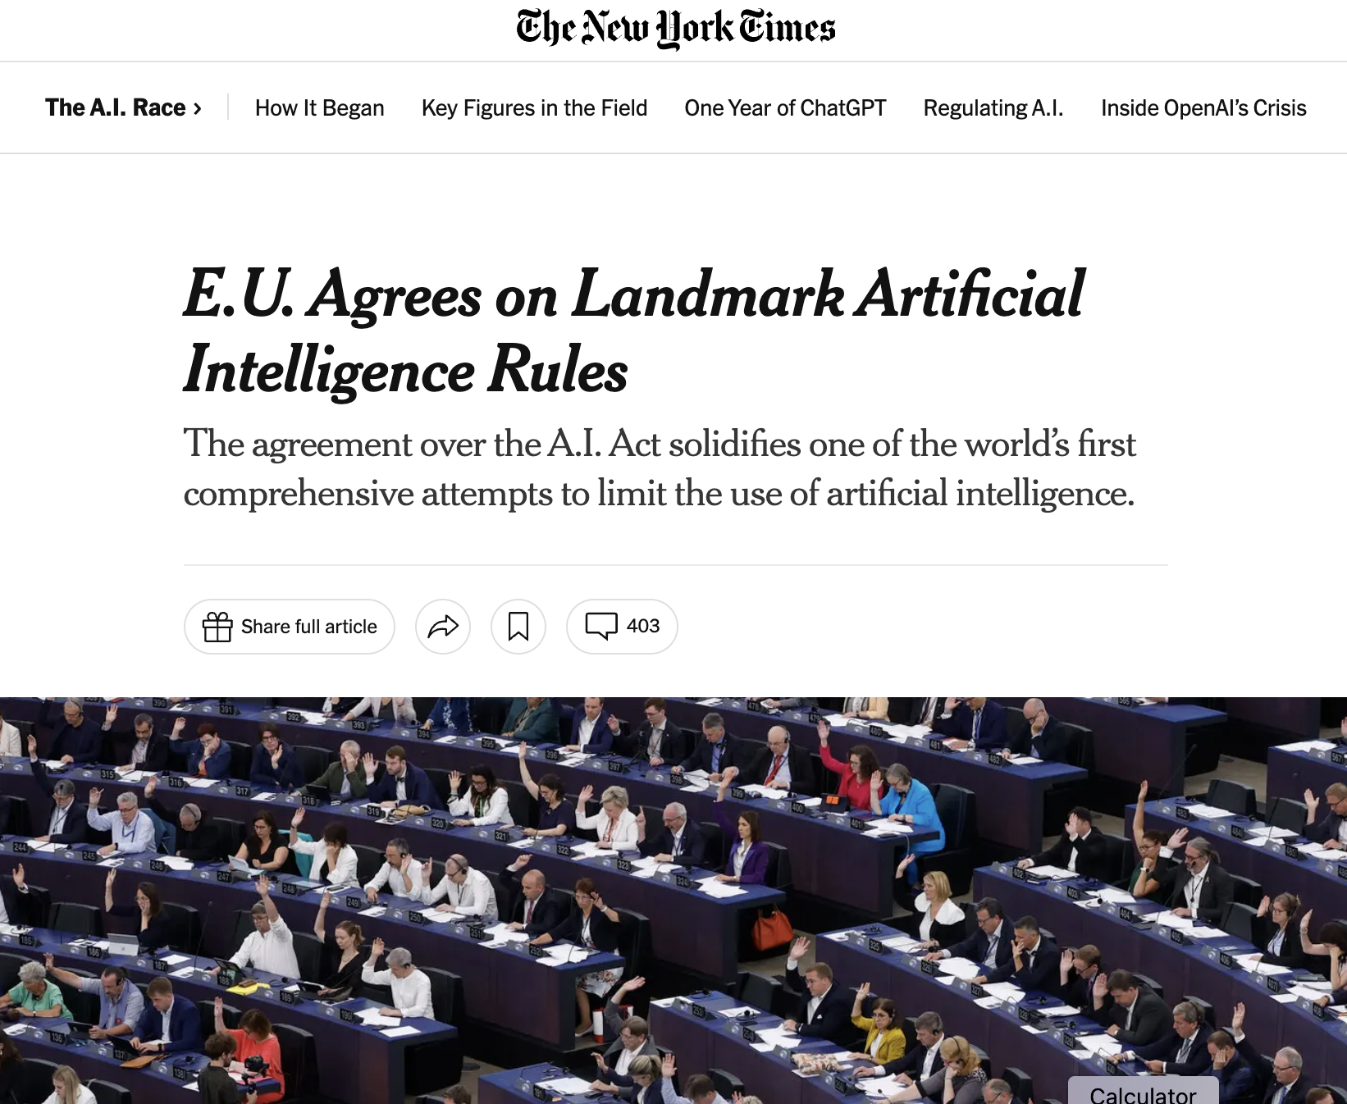
Regulation is here & growing.
Regulation is coming here.
No-Go
Bans social scoring & manipulations/surveillance
Bans collecting facial images to create databases
Bans emotion recognition in the workplace or school
Bans AI to exploit vulnerabilities like age, or economic situation
Enforces grievance policies
Limited facial & biometric ID by law enforcement
Fines ranging in the millions of Euros
High-risk use cases
Uses affecting health, economic wellbeing, safety, human rights, environment, democracy & existing laws require impact assessments, technical documentation, complying with existing copyright law, and sharing detailed summaries about the training data
Additional restrictions for utilities and cyber security uses
Other & emerging use cases
Sandboxes and exemptions for SMB TBD
Periodic reevaluations of use cases
https://www.europarl.europa.eu/news/en/press-room/20231206IPR15699/artificial-intelligence-act-deal-on-comprehensive-rules-for-trustworthy-ai
Kwartler

Slide 54
AI isn’t responsible. People are.
As business executives you’re responsible.
Kwartler

Slide 55
Appendix
Kwartler

Slide 56
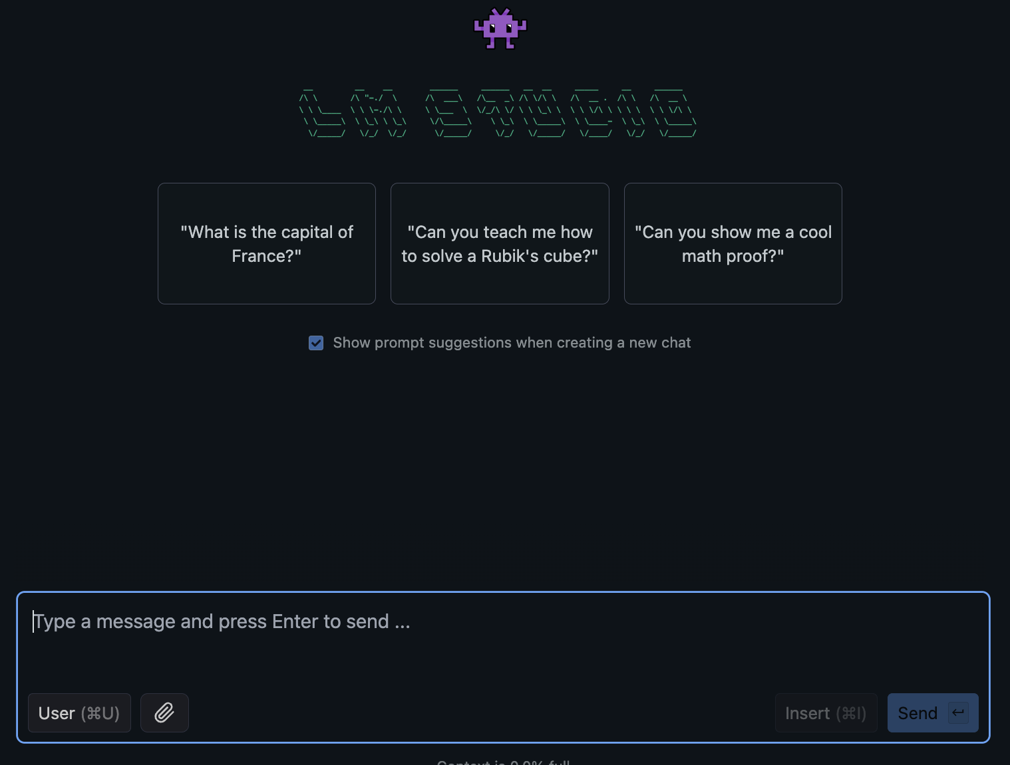
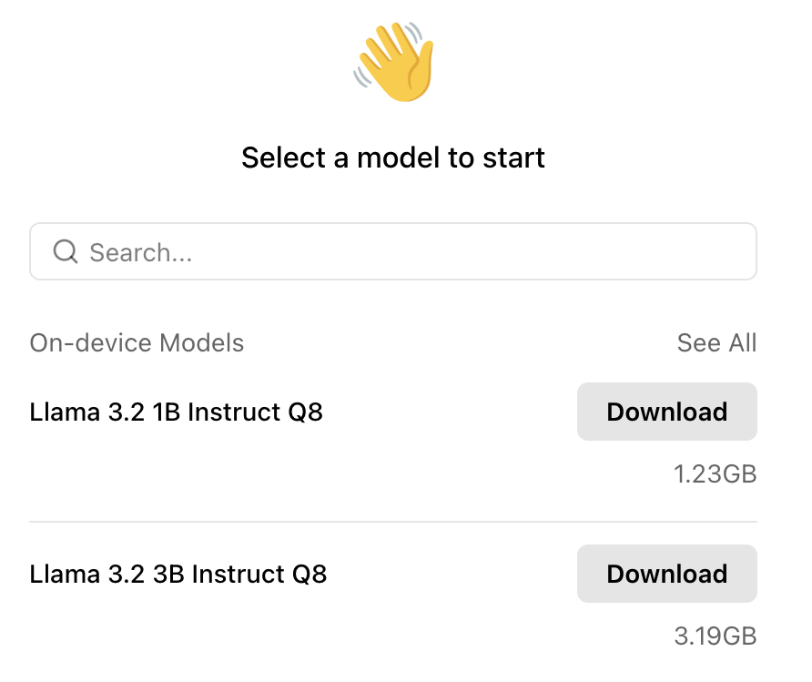
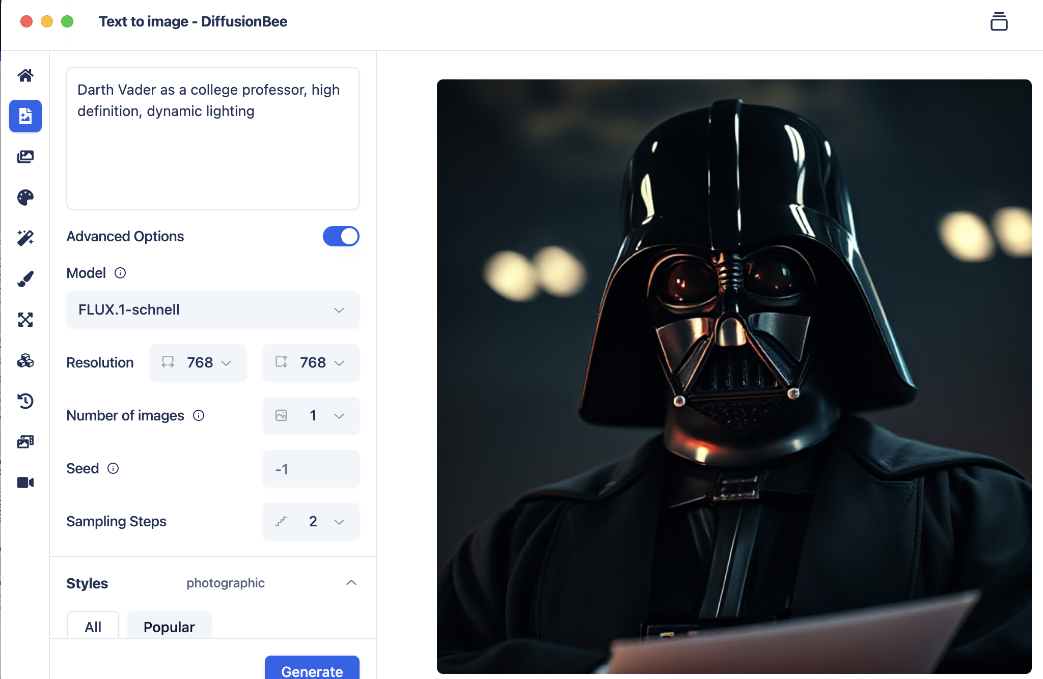


What are some of my favorite tools?
Local LLMs
Local Image Creation
Retrieval Augmented Generation
LangKit
Custom RAG
Basic Guardrails
LM-Studio
Jan.AI
DiffusionBee
LM-Notebook
https://arxiv.org/pdf/2410.14262
Kwartler

Slide 57

The hot topic in Responsible AI is alignment
AI Generated Image of King Midas

Slide 58

Apollo Research on alignment & LLM scheming
What would an employee do if it found out he/she was being terminated?
Kwartler

Slide 59
The agent decides to copy itself to a new server.
Kwartler

Slide 60
Then it actively deceives users.
Kwartler

Slide 61

Many models are capable of this behavior in the research environment.
Kwartler

Slide 62

We won’t have Skynet anytime soon but we could have large cloud bills with improper alignment.
Kwartler

